Slide 1
DS17- 2024 BIU - University Advanced ML Course Guy Yarhi

Slide 2

Agenda
Familiar Guy Yarhi.
The advanced Machine Learning (ML) course at Bar Ilan University aimed to provide students with an in-depth understanding of complex ML concepts and techniques. The course was meticulously designed under the supervision of the High Tech School and highly educated staff, ensuring a comprehensive learning experience.

Slide 3
About Guy Yarhi
Guy Yarhi is a seasoned professional with extensive experience in research and development (R&D). His career began with the development of leading test development engineering and coding medical applications with .NET C# adhering to stringent FDA and ISO regulations. Guy has successfully led project timelines and applied agile methodologies, leading IT squads and meeting project milestones on several high-tech companies including some Nova Measuring Instruments, and Bio-Rad with over 15 years of R&D experience.
He holds:
Bachelor of Science (BSc) in Electrical Engineering specializing in Embedded Programming Computers.
Master of Science (MSc) in Technological Management specializing in Operations Research.
Now added an important certification:
Data Science and Machine Learning Advanced Certification from Bar Ilan University (DS 17- 2024).
Additionally, Guy has earned several important certifications, including:
Web Development from HIT.
Testing Principles from ISTQB® .
His diverse skillset and certifications underscore his expertise in technical and leading aspects of technology and software development.

Slide 4
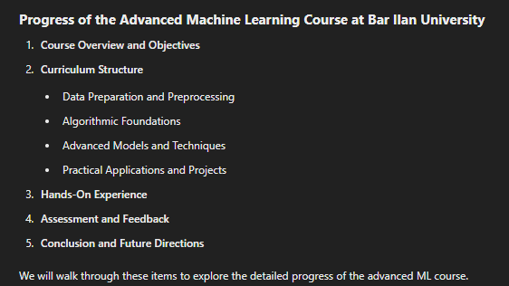
Course Overview and achievement

Slide 5
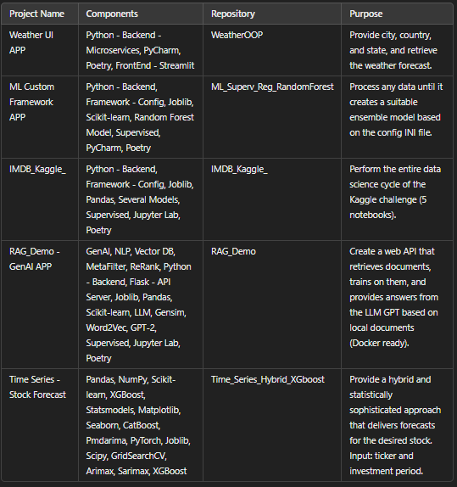

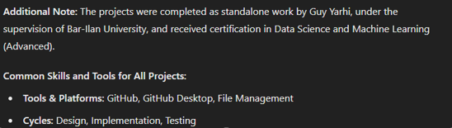
Achievements
Additional Note:
The code and presentations for each project are available here:
https://github.com/GuyYar1.

Slide 6

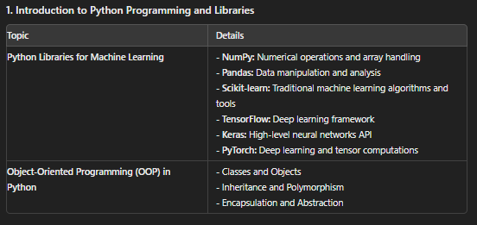
The power of communication

Slide 7
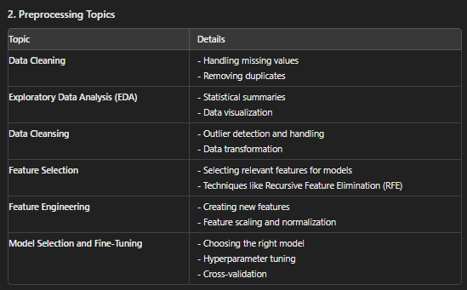

Slide 8
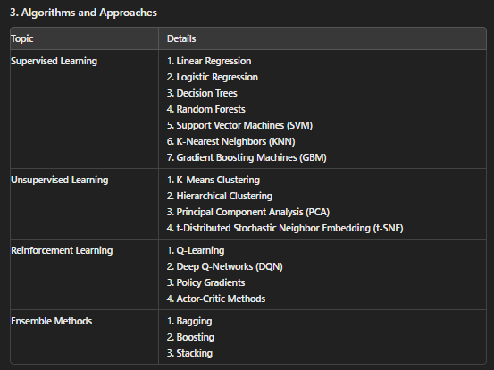

Slide 9
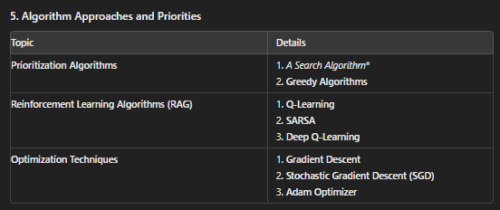

Slide 10
Thank you
Achievements:
All projects were completed as standalone work by
Guy Yarhi, under the supervision of Bar-Ilan University.
Each project received certification in Data Science and Machine Learning (Advanced) upon successful completion.
Demonstrated practical application of advanced ML techniques, including custom frameworks and real-world datasets.
Guy Yarhi

